Slide 1
Module-4
AWS Database Services

Slide 2
AWS Database Services
AWS Database ServiceS, Amazon RDS (Relational Database Service), RDS Multi-AZ Deployments, RDS Read Replicas, Amazon Aurora, Amazon DynamoDB, DynamoDB Streams

Slide 3
AWS Database Services
Relational Database Service (RDS)
Amazon Aurora
Amazon DynamoDB

Slide 4
A database is a collection of organized data that is stored electronically in a computer system. The purpose of a database is to make data easier to manage and access.

Slide 5
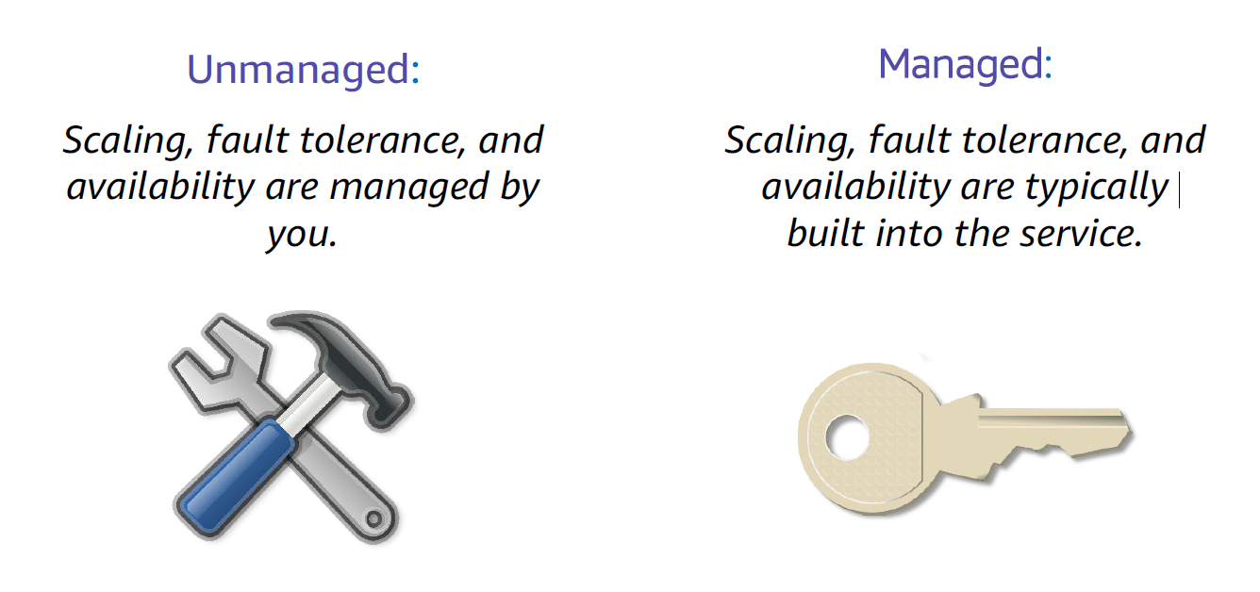
Unmanaged versus managed services

Slide 6
Challenges of relational databases
Server maintenance and energy
Software installation and patches
Database backups and high availability
Limits on scalability
Data security
Operating system (OS) installation and patches

Slide 7
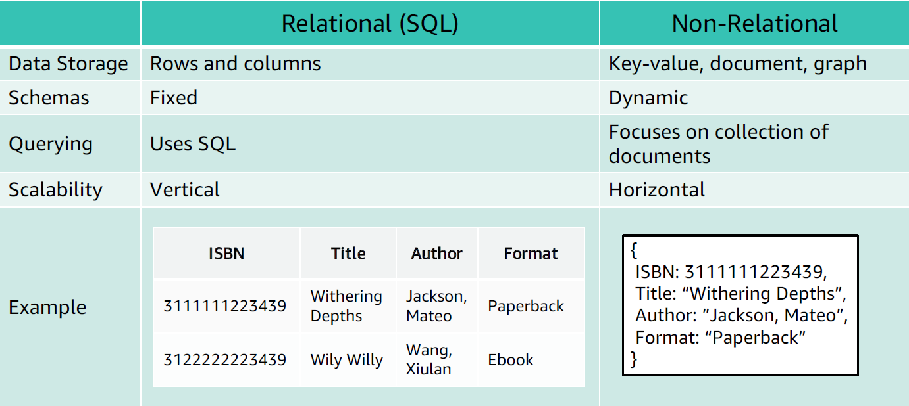

Slide 8
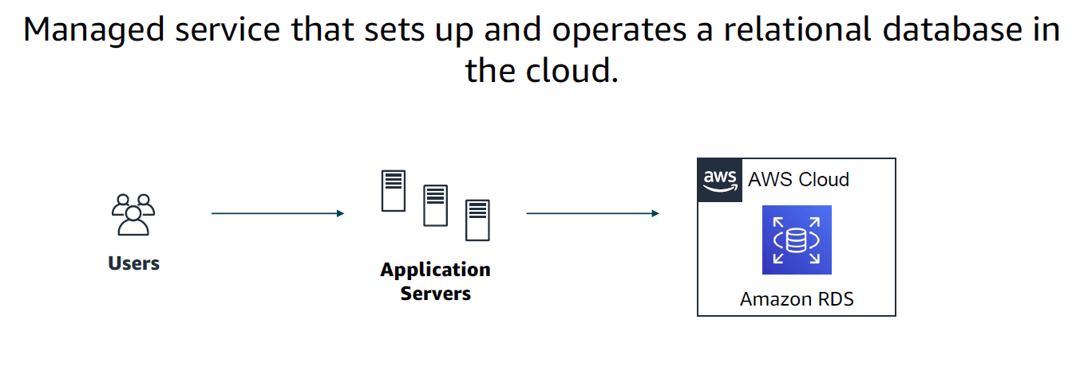

Slide 9
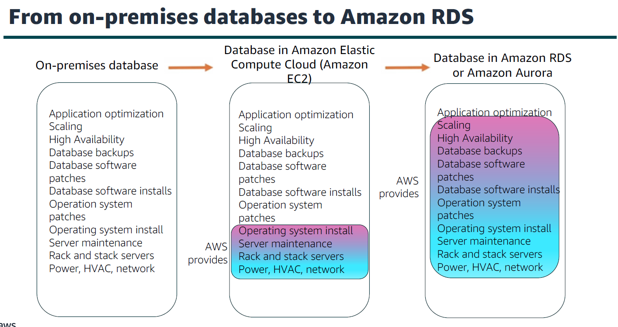

Slide 10
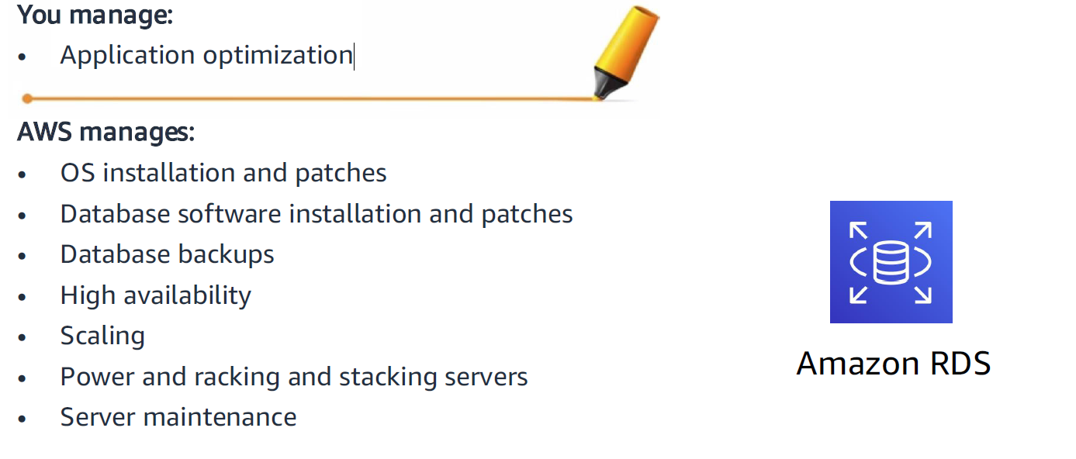
Managed services responsibilities

Slide 11
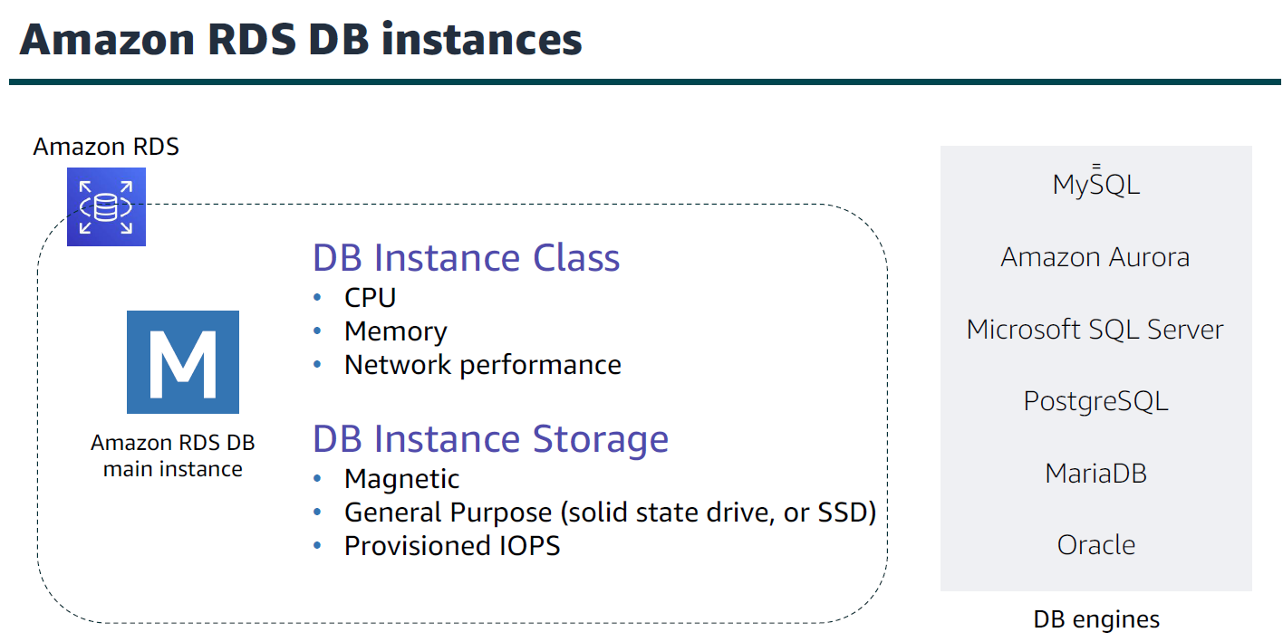

Slide 12
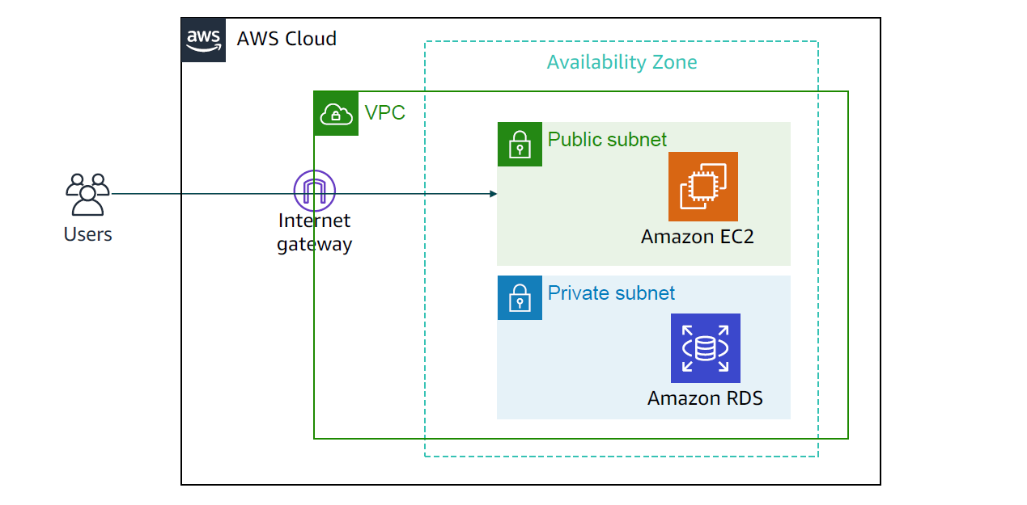
Amazon RDS in a virtual private cloud (VPC)

Slide 13
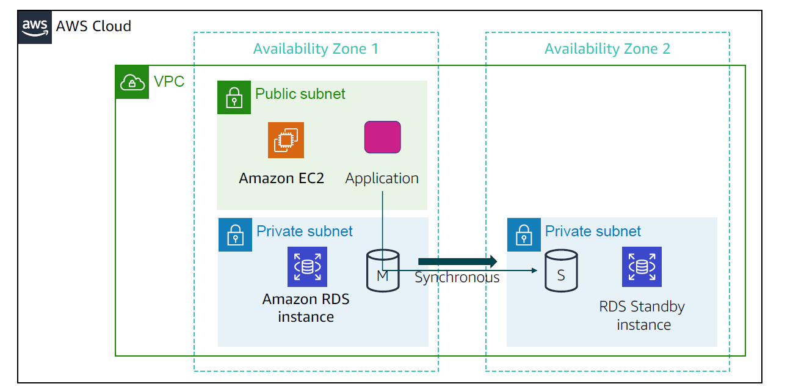
High availability with Multi-AZ deployment (2 of 2)

Slide 14
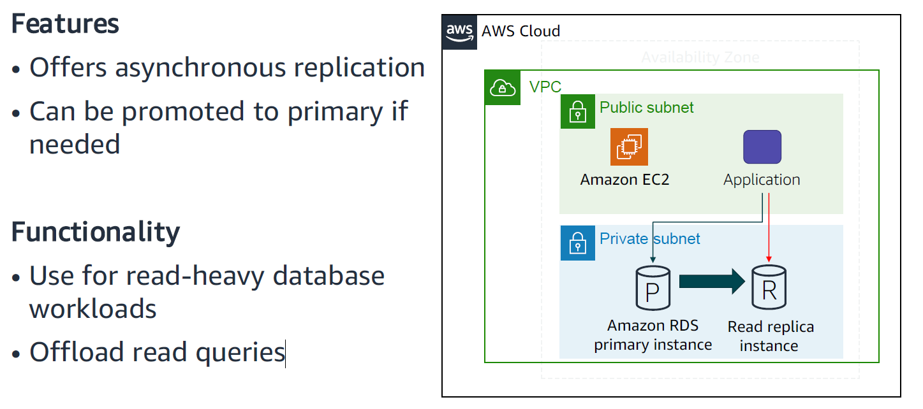
Amazon RDS read replicas

Slide 15
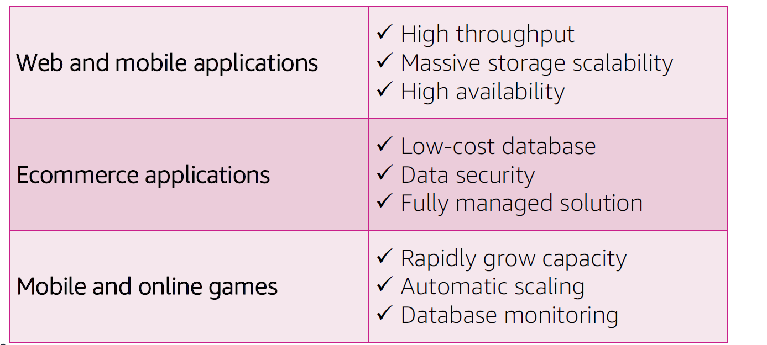
Use cases

Slide 16
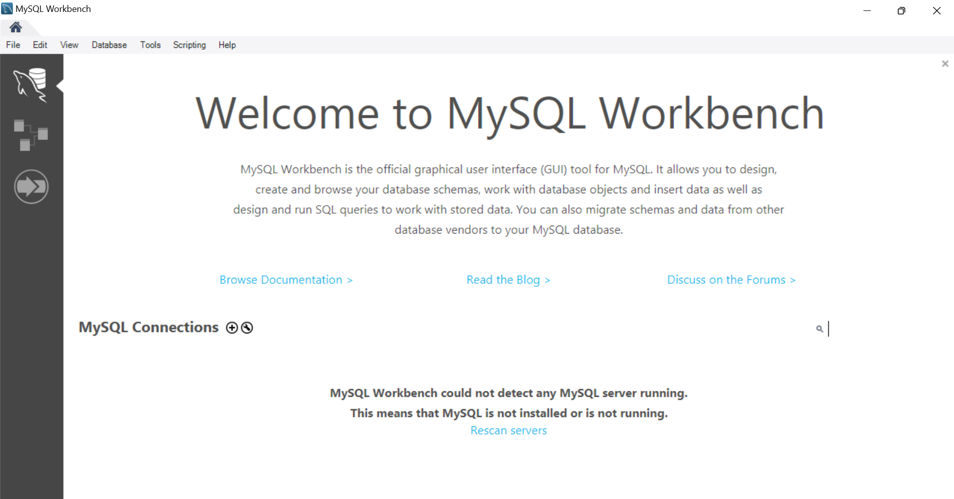
Mysql connect with mysql workbench

Slide 17
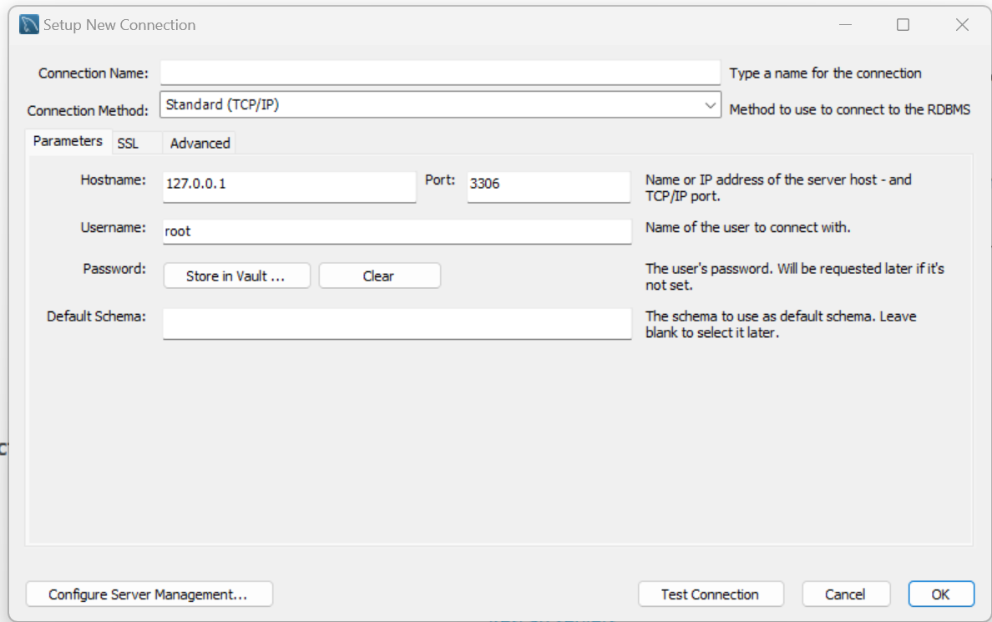

Slide 18
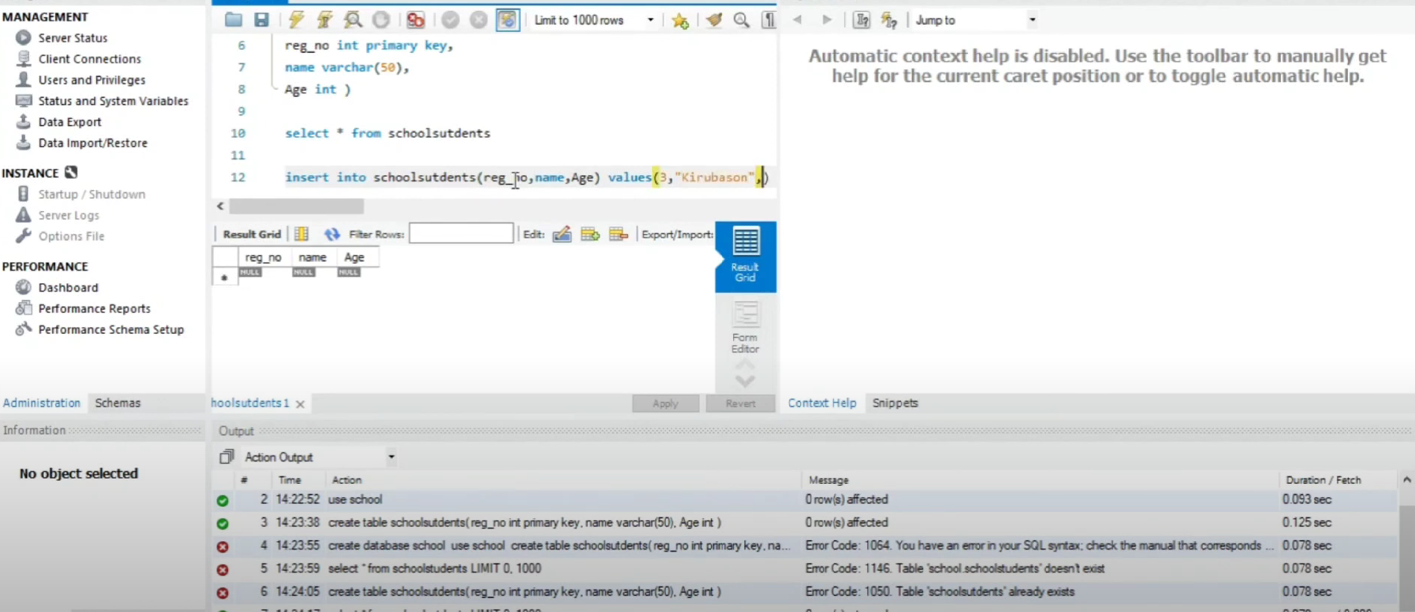

Slide 19
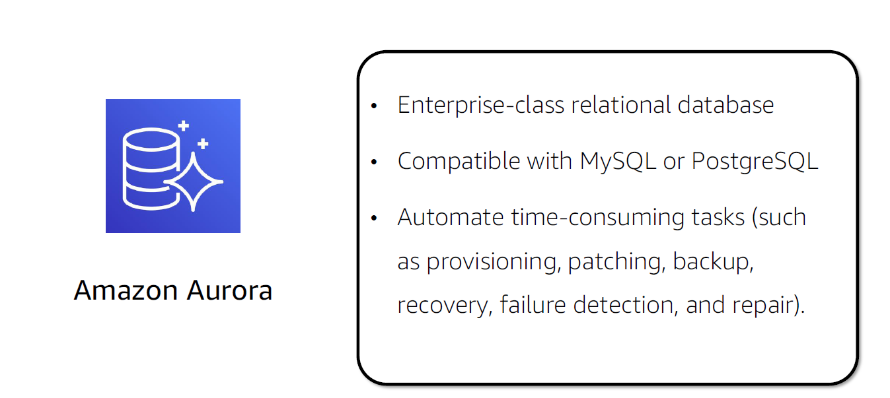
Aurora

Slide 20
Aurora is proprietary technology from AWS.
Mysql and Postgres are both supported as Aurora DB.
Storage automatically grows increments of 10 GB to 64 TB.
Aurora cost more than RDS(20 % more) but more efficient.
Not in the free tier.

Slide 21
High Performance and Scalability
Aurora is “ AWS cloud optimized” and claims 5X performacne improvement over Mysql on RDS
3X performacne improvement over Postgre on RDS.

Slide 22
High Availability and durability
99.99% Availability.
Replicating 6 copies of data across 3AZ and backup data continuously to Amazon S3.
Transparently recovers from physical storage failure.
Instance backup takes less than 30 seconds without any data loss.

Slide 23
Highly Secure
Amazon VPC used for network isolation.
Data transfer happened by AWS KMS key encryption( snaphot / backup)

Slide 24
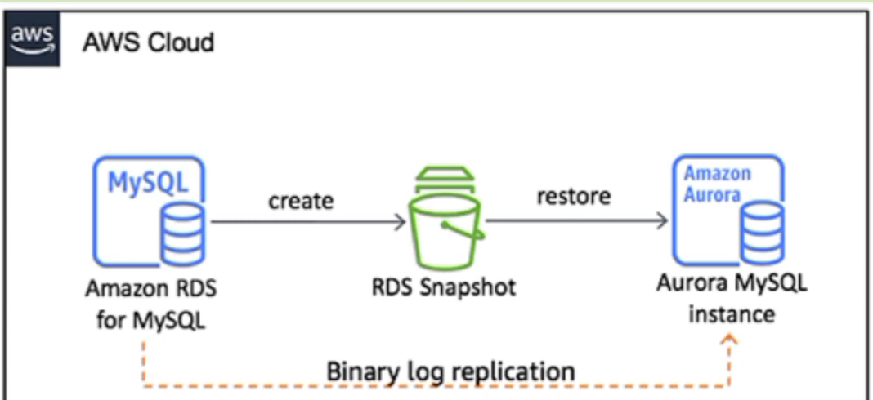
Mysql & Postgres Compatible
Easy migrate from this to Amazon Aurora.
Import/Export completely manageable.

Slide 25
Fully Managed
Hardware provisioning
Software patching
DB setup
Configuration.
Backup

Slide 26
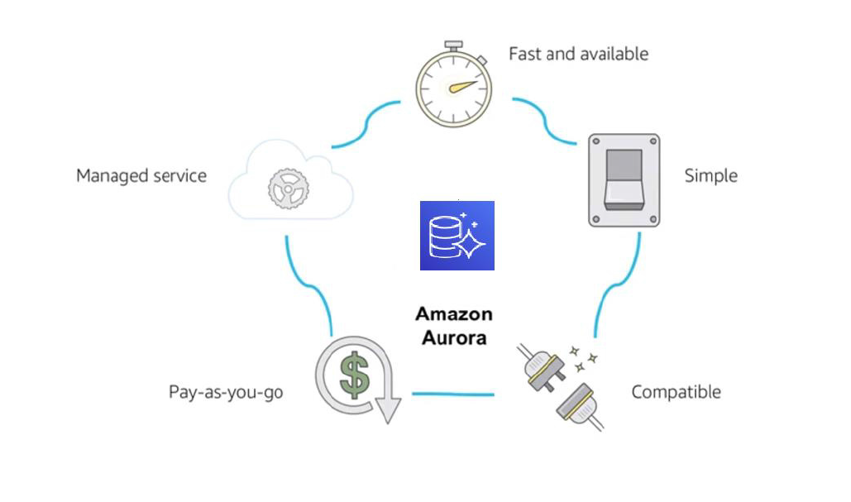
Benefits

Slide 27
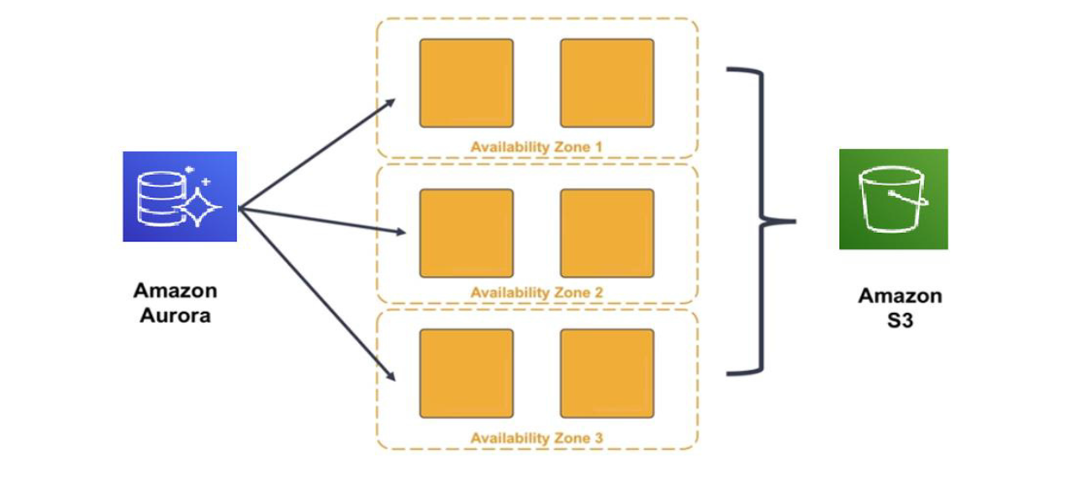
High availability

Slide 28
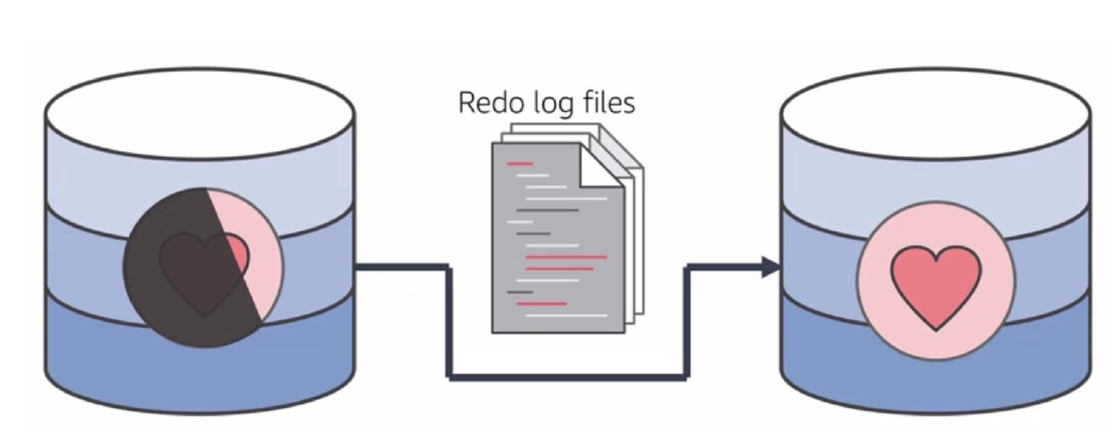
Resilient design (Ex.quickly recover from disruptions like natural disasters)

Slide 29
Amazon DynamoDB
Relational versus non-relational databases

Slide 30
Relational Databases (RDBMS)
Examples in AWS: Amazon RDS (MySQL, PostgreSQL, MariaDB, Oracle, SQL Server), Amazon Aurora.
Data Structure: Data is organized into tables with predefined schemas (rows and columns), supporting structured data and relational models.
Schema Requirements: Requires a fixed schema, meaning data must conform to a defined structure.

Slide 31
Non-Relational Databases (NoSQL)
Examples in AWS: Amazon DynamoDB, Amazon DocumentDB (MongoDB-compatible), Amazon Keyspaces (for Apache Cassandra).
Data Structure: Flexible data models like key-value, document-based, wide column, or graph. Data is typically stored in a denormalized format, reducing the need for joins.

Slide 32
DynamoDB Streams
DynamoDB Streams writes stream records in near-real time so that you can build applications that consume these streams and take action based on the contents.

Slide 33
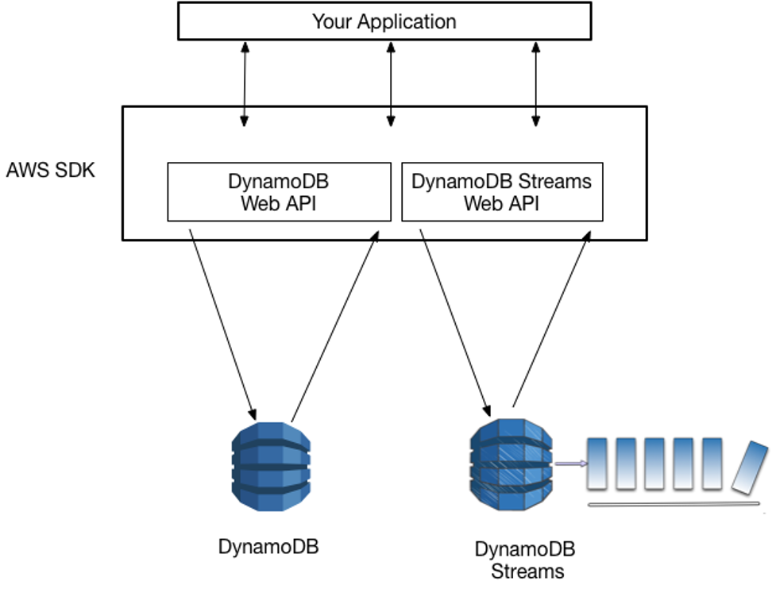
Accessing DynamoDB and DynamoDB Streams

